Slide 1
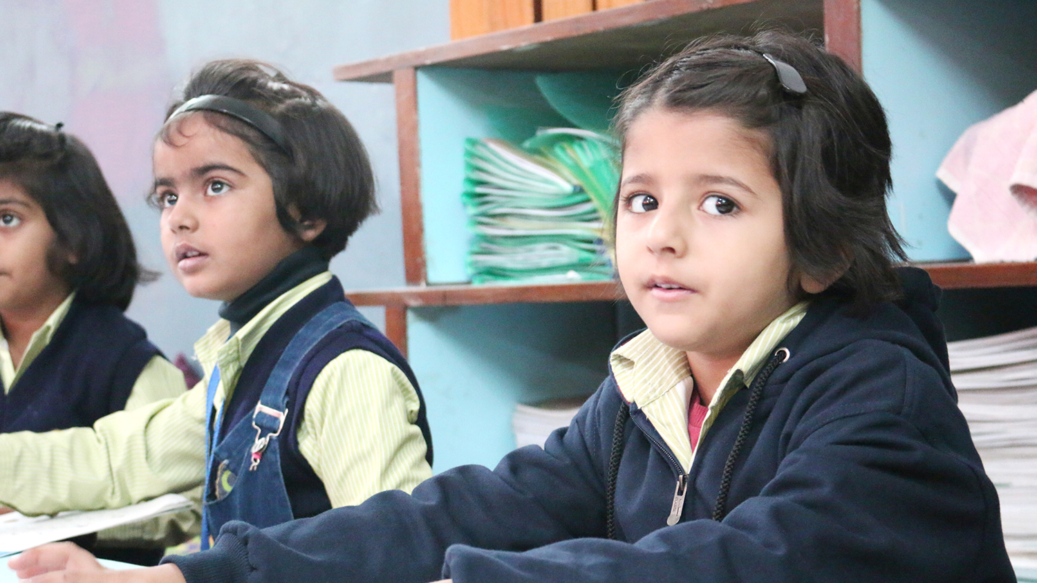

CREATE A NEW LEGACY
In K-12
CBSE / ICSE
CAIE / IB Schools

Slide 2

“
Lead Change in Education.
Make World a Better Place.

Slide 3
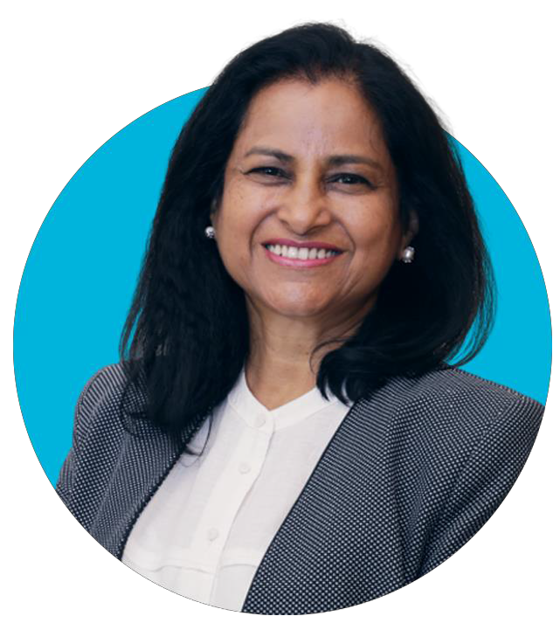


Team Up With Experience.
Dr Sunita Gandhi
Founder, Global Classroom Pvt. Ltd.
Visionary of UP Award
Educator of the Year, India Book of Records
‘Most Outstanding Contribution to Development Award’, World Bank Best Woman Start-up Entrepreneur, IIM Lucknow
Based on the philosophical framework for education conceptualized by Dr Sunita Gandhi, PhD, Cambridge University, UK, President and Co-Founder, Council for Global Education, USA, Educator, Author, Innovator and Researcher with experience of travelling to and studying education systems in 39 countries
Council for
Global Education, USA
www.globaleducation.org
www.edleader.in

Slide 4


Research by Dr. Gandhi in the UK,
Iceland and India shows the principle of Ipsative improves learning outcome.
Check out on the Internet:
*Gandhi S. (2017) Compete With Yourself (CWY): Maximising Learning Gain in Schools. In: Hughes G. (eds) Ipsative Assessment and Personal Learning Gain. Palgrave Macmillan, London

Slide 5

TEAM UP WITH EXPERIENCE
Education Background: Global Classroom was founded by Dr. Sunita Gandhi, a visionary educator from the family that runs the world’s largest school with 57,000 students. CMS is a Guinness World Record Holder and recipient of the UNESCO Prize for Peace Education. CMS has produced India’s best results year after year and the maximum number of national rank toppers.
Legacy & Experience: Coming from a background of pedigree educators, we understand the challenges schools face, whether it is enrolment, performance, or retention of parents, and hence offer solutions that are win-win for all stakeholders. We are committed to offer holistic improvement and a true partnership in every sense.
Innovative & Research-Based: Global Classroom is the most innovative K-12 managed schools group.
Exclusivity: Global Classroom is unique with its own in-house school system, curriculum, Ed-Tech, and R&D departments, along with an international team that provide exclusive solutions to our partner schools.
Transparency, Accountability and Standardization: Global Classroom is the first education house to provide standardization in academics, transparency and accountability through its proprietary diagnostic assessments, in-house advanced curriculum & training, quality audits and supervision, and more.
Advantages for School Owners
Provide better returns
Make each GC-supported school amongst the top performing schools of a city

Slide 6
COMPREHENSIVE SUPPORT
CBSE | ICSE | CAIE | IB
Management, Franchise, Handholding
Teacher Training
Curriculum
Assessments
Run, manage and provide support to Company Owned and Franchise schools all over India
A Complete Learning System: Global ME!
Based on the principle of the Ipsative: Compete with Yourself; research shows this helps children succeed more
Training Modules deliver holistic training

Slide 7


OVERVIEW
More than 20 managed schools
Supported by a broad base of research and the rigorous exploration of education systems around the world
Backed by Dr Gandhi’s family know-how of running the world’s largest school with 55000 students, a Guinness World Record holder—City Montessori School, Lucknow—also the world’s
first school to receive the prestigious UNESCO Prize for Peace Education
Own proprietary curriculum perfected with multi-year trial in three countries: Iceland, UK and India
World's first assessments based on the principle of 'Compete with Yourself’ based on Dr Gandhi’s research on Ipsative Assessments published in 2017 in the UK

Slide 8
“
WRITE YOUR OWN
SUCCESS STORY

Slide 9
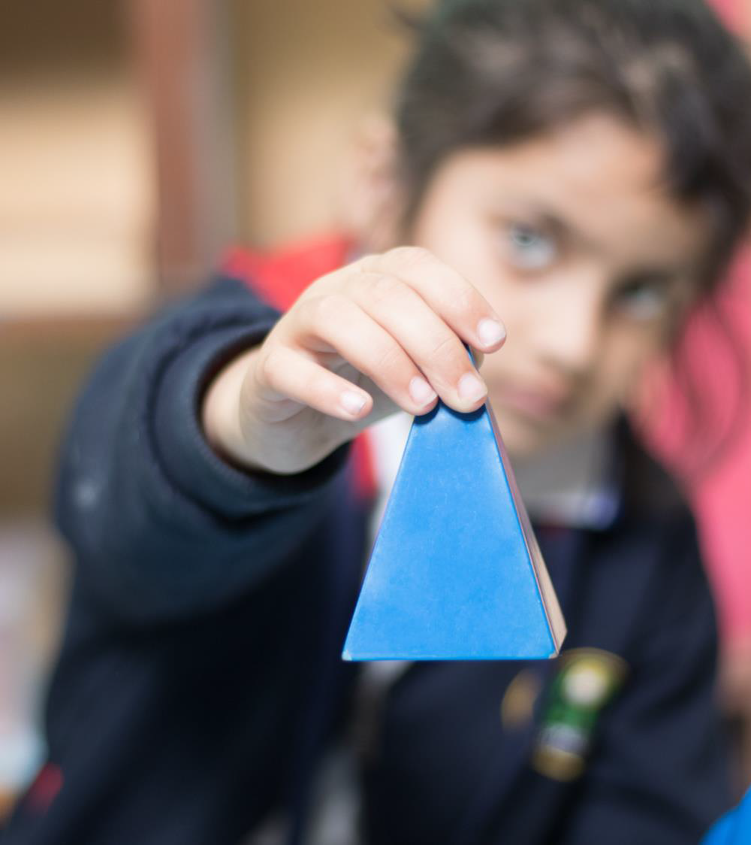
STARTING A SCHOOL IS NOT EASY
It is even harder to raise quality year after year.
Once a school image is formed, it is hard to change it.
Once the teachers are already hired, it is hard to replace them.
Once the books and the curriculum are already defined, it is hard to make changes.
The furniture you buy, defines your pedagogy.
The proper planning of the school’s facilities defines your school’s commitment to quality.
The brand you choose defines the next set of possibilities for your school.

Slide 10

Impact
“
Global Classroom, started in 2007, currently manages 27 schools and supports academics at some 800 schools pan India that includes the world’s largest school with 57,000 students in this academic session. This is City Montessori School, Lucknow, a Guinness World Record Holder and Recipient, UNESCO Prize for Peace Education.
The vision of Global Classroom is to create a better world by providing a broader, bolder, holistic, and more meaningful education.
The mission of Global Classroom is provide a demonstration value of its grand vision in schools managed and run by it.

Slide 11



SUPPORT FOR SUCCESS
School branding under the banner of City International School
& Nurture International School
BUILDING CONCEPT
& DESIGN
HELP IN STRUCTURING THE SCHOOL
OUTREACH & PARENT COMMUNICATIONS
HELP IN IDENTIFYING HIGH QUALITY HUMAN RESOURCES
CHILD-CENTRIC CURRICULUM
& ITS IMPLEMENTATION
ONGOING PRINCIPAL AND TEACHER'S TRAINING
REGULAR AUDIT & SUPERVISION (ACADEMIC AND NON-ACADEMIC)
HELP WITH MARKETING AND COMMUNICATION
HAND HOLDING FOR APPROVALS (CBSE / OTHER NATIONAL
& INTERNATIONAL BOARDS)
*All out of pocket expenses are paid by the franchisee.

Slide 12

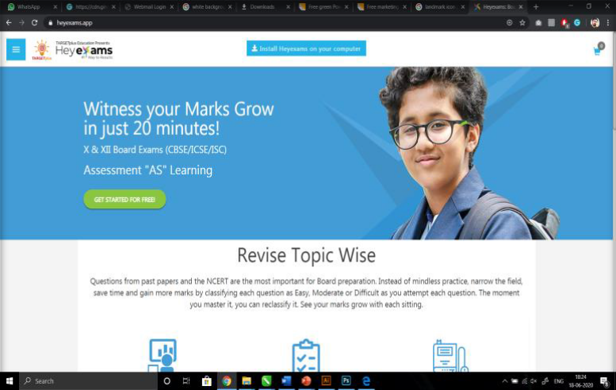

World Class Academics
w w w . h e y e x a m s . a p p
Global Classroom provides an exclusive proprietary curriculum to its managed schools that is comprehensive, child-friendly, and based on worldwide research and evidence.
This includes all books and assessments for all classes from playgroup to Class 8, and for Board success. It’s Heyexams and iversusi learning platform has produced proven success for the world’s largest school and others in India.
Place your screenshot here
The curriculum is based on principle of the Ipsative: Compete with Self dynamics that brings out the best in every child.
Global Classroom has an in-house R & D team that continuously researches on new and next practices and engages educators and content writers from across the world including Finland, UK, Australia and the US, among others.

Slide 13
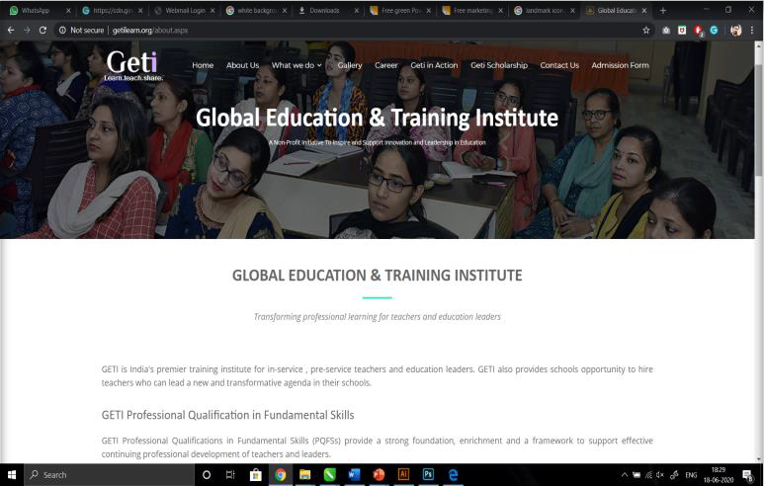
Training and Support
w w w . g e t i l e a r n . a p p
Global Classroom provides training through its affiliate organization Global Education & Training Institute that has customized its training to the Global Classroom curriculum to make it most relevant. GETI also provides supervision and audits as third-party evaluators.
Global Classroom provides assessments to all its campuses to set common standards and to raise the bar on learning, to monitor every child’s progress on a real time basis.
Place your screenshot here
Global Classroom uses its own exclusive ERP and Online Classes within its premises and by its teachers.

Slide 14

India's most effective
curriculum provides
Clear instructional goals
High expectation for achievement
Small concept-based instructional tiers
Clear accomplishment standards
Personalised work plans based on ‘Compete with Yourself’ assessments
Use of varied methods until understanding is reached
Immediate feedback combined with the right level of support and challenge
Clear and up-to-date records of student progress
Personalised learning

Slide 15

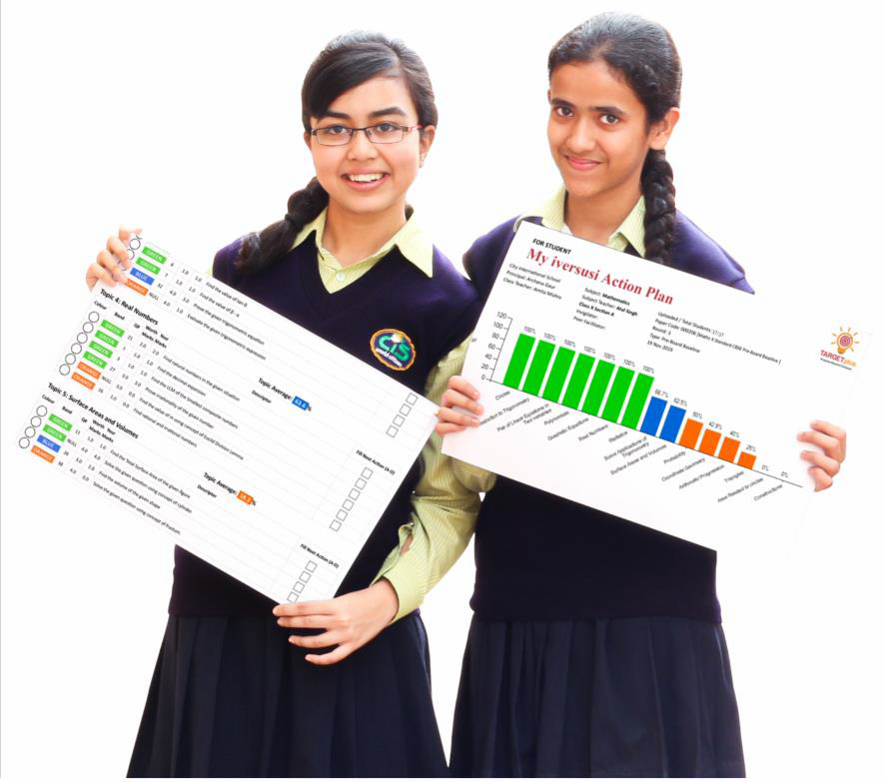
STANDARDISATION THROUGH
ASSESSMENTS & REPORTS
Assessments are “for” and “as” learning, besides “of” learning
Assessments are based on the more powerful principle of the Ipsative: Compete with yourself!
Dual mastery iversusi assessments are monitored 6 times a year in each subject and focus area to bring the best in every child
Reports feed forward and answer the question, “What next?”
Progress is measured and celebrated six times a year at least
Ipsative: Dual Mastery Assessments

Slide 16
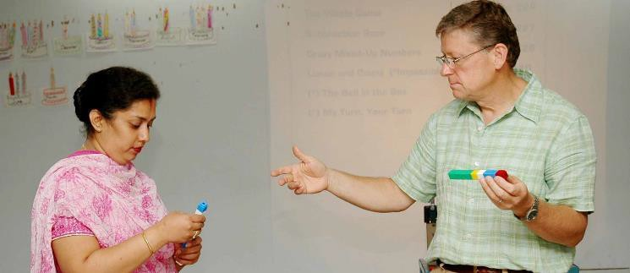
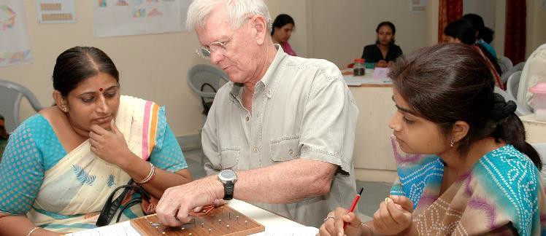

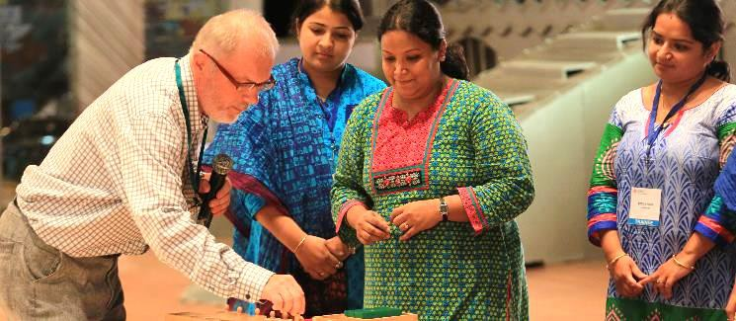

TRAINING & SUPPORT
Training that ‘sticks’
Support for quality of implementation along with unannounced audits
WhatsApp, and Email support 24/7
Christopher Weinhold, USA
International Trainers and guest presenters from the world’s topmost performing countries bring evidence and share next practices in their countries: Australia, Finland, Singapore, and New Zealand, among others
These countries are top performers in PISA examinations. Their 15 year olds perform the best in the world and are 3 to 7 years ahead in academics compared with 15 year olds in many countries
Richard Cossen, USA
James Pearce, INDIA

Slide 17
























Dr. Susan Hama |  | Prof. Hanna Ragnarsdottir |  | Prof. Shun-Wing Ng |  | Prof. Fred Mednick |  | Prof. Mari Paullina |  | Dr. David Franklin
Iceland |  | Iceland |  | Hong Kong |  | USA |  | Finland |  | USA
Prof. Vicki Zakrzewski
USA
Ms Pirjo Koivula, Finland
Dr. Sunita Gandhi India
Ms Irmeli Halinen Finland
EMINENT ADVISORY

Slide 18
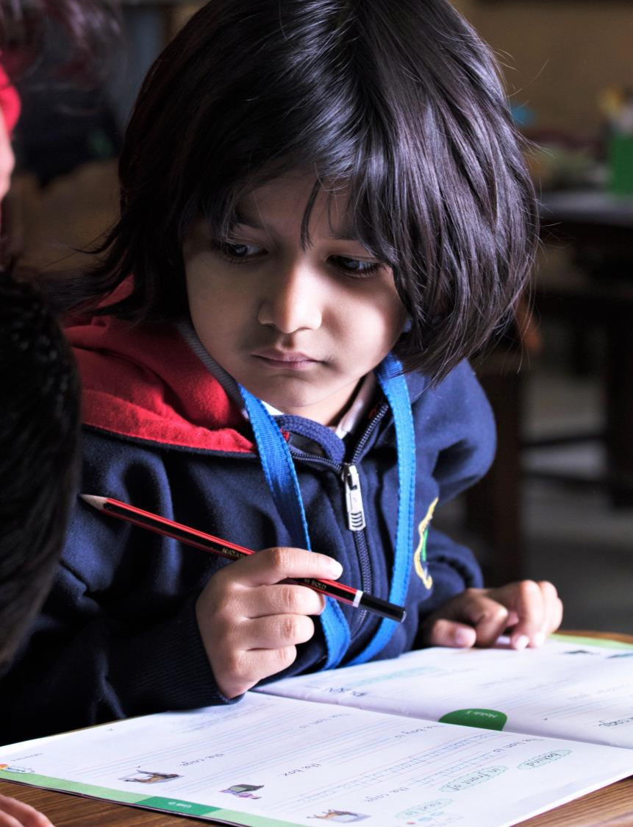
OUTCOMES
Global Classroom holds on to high standards of performance at all levels, ensuring a broader and bolder education that every child deserves and that every parent is looking for.
“
This includes:
India’s best academic results
Conﬁdent, competent and caring children
Self-regulated and self-controlled, able to take care of themselves
Respectful, courteous and mannered
Independent thinkers
Team players and leaders
Creative and curious of a growth minds that enjoy taking on new challenges
World citizens

Slide 19

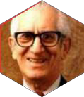
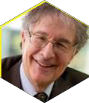
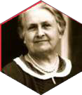
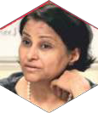
An Advanced Pedagogy
1861-1925
Dr Rudolf Steiner
Waldorf Method
The Global Classroom Method of Schooling uses advanced pedagogy and integrates the pedagogies of the world’s best education systems and thinkers: Dr. Rudolf Steiner, Dr. Maria Montessori, Dr. Benjamin Bloom & Prof. Howard Gardner. We use framework of the Four Building Blocks of Education, and Twelve Governing Principles of the Council for Global Education, USA. We also mainstream the principle of the Ipsative: Compared with Self*.
1913-1999
Dr Benjamin
Bloom
Cognitive
Levels of Learning
1946-Present
Prof Howard Gardner
Prof Harvard University, USA
Multiple Intelligences
1870-1952
Dr Maria Montessori
Montessori
Method
“In the future, all children will compete with themselves.
In Global Classrooms, they already do.”
Author
Dr Sunita Gandhi Innovator, Author Alumna, Cambridge University, UK
Visionary Educator,
Researcher

Slide 20
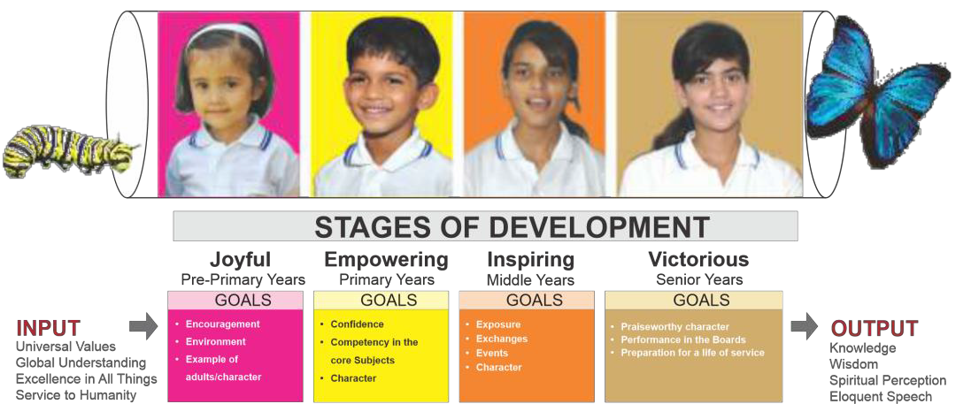
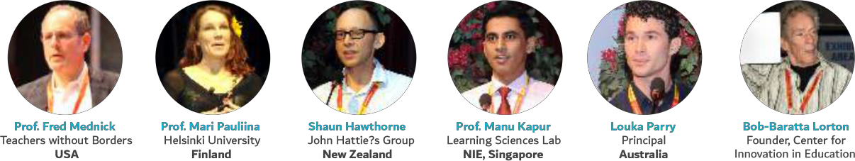
Global Classroom: A Broader and Bolder Education
Global Classroom’s curriculum has been vetted by experts on four continents including educationists from Iceland, Finland, Cambridge, Harvard, Oxford and Standard Universities, among others

Slide 21
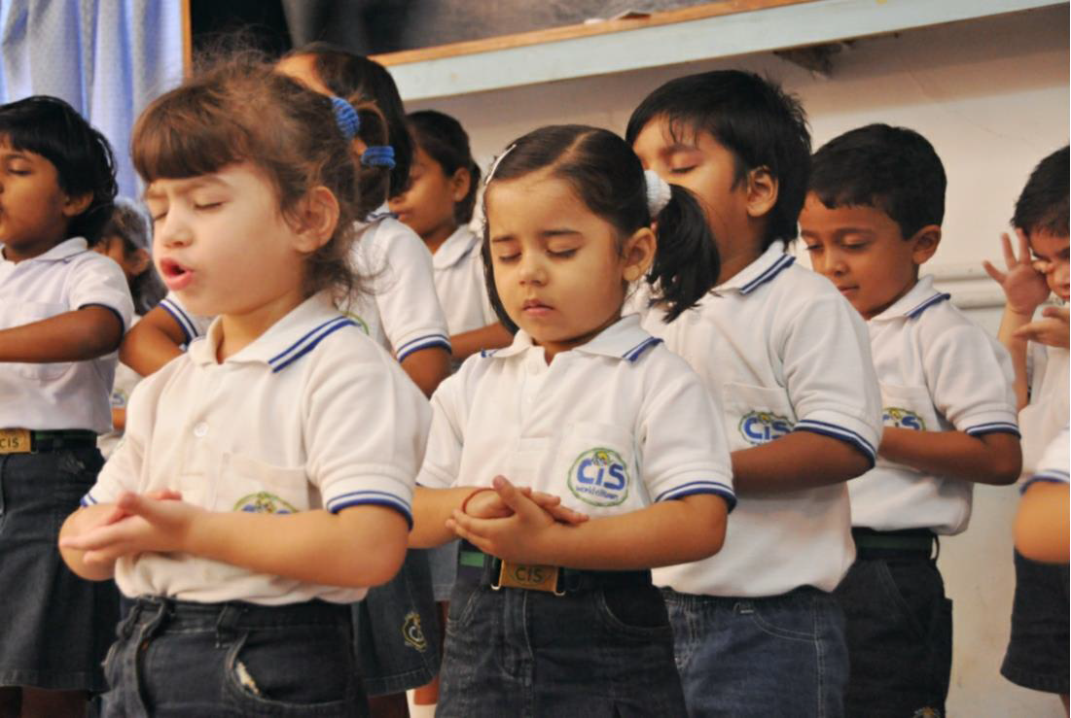


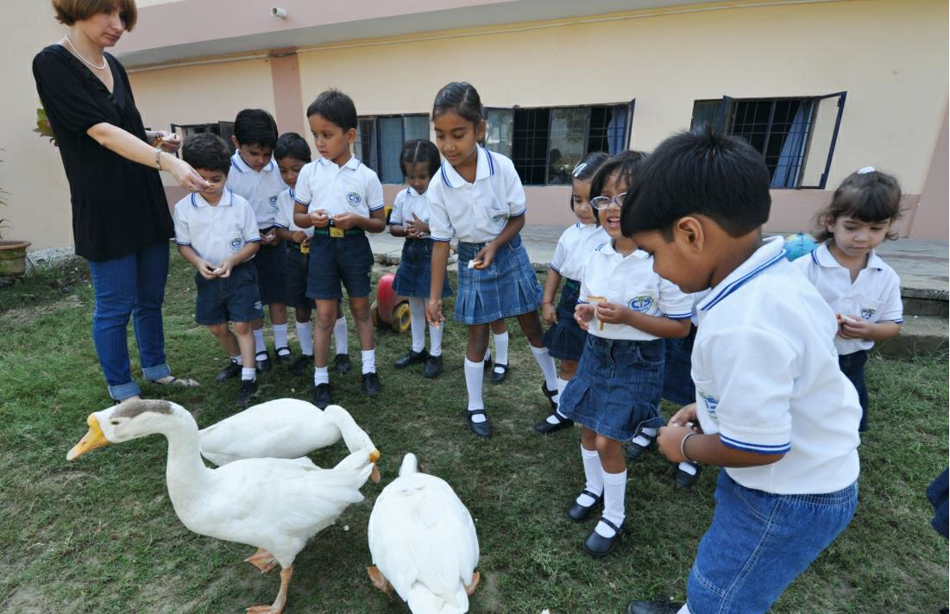
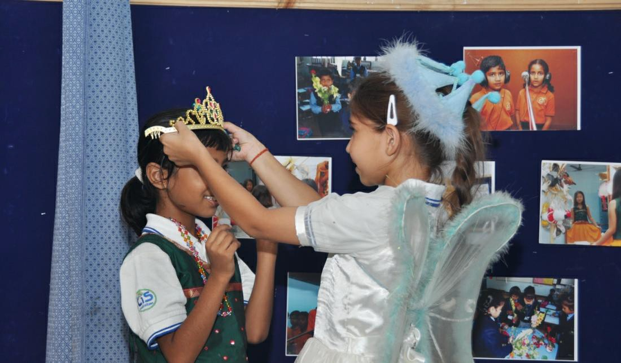
Universal Values
Global Understanding
Excellence in All Things
Service to Humanity
A Vision-Led Education of the
FOUR BUILDING BLOCKS OF EDUCATION
of the Council for Global Education, USA

Slide 22
AREAS OF SUPPORT TO A PARTNER
* All out of pocket expenses are covered by the promoter (not GCPL)

Slide 23
A. KNOW-HOW & BRANDING
A1: Branding
A2: Know-How
A3: Standards
Performance Standards Satisfaction Surveys Student Progress Reports Teacher Performance Metrix School Growth
Supervision
Nurture International School City International School Mini Planet
Know-how of running schools Best academic results Curriculum & Assessments Teachers Training

Slide 24
B. OPERATIONS KNOW-HOW & SUPPORT
B1: Know-How & Support
B2: Operations Support
NOC
CBSE / other national Boards IB / Cambridge, etc. International
Boards
ERP
Forms

Slide 25
C. PROMOTIONS SUPPORT
C1: Designing
C2: Events Planning
C3: Social Media Support
Prospectus Website Flyers Hoardings
Media / Press Releases Teacher and Staff Hiring Ads
Open Days Cultural Events
Promotional Activities Door to Door Activities Special Events like tie ups with Industry
Social Media Marketing Likes Management
Search Engine Optimization
Facebook Campaigns
Google Ad Words, Etc.

Slide 26
D. OUTREACH & PARENT COMMUNICATIONS GUIDELINES
D2: Parent Communications
D1: Parent Events
D3: Other Events
Parent Orientations Parent Seminars & Workshops
Parent Teacher Meetings Other Events for Parents
Class Presentations Parent Report Cards
Other Parent Communications
Parent Feedback & Surveys
Annual Sports Days Annual Days
Science Exhibitions, Etc.
Community Outreach

Slide 27
E. ACADEMICS
E1: Curriculum
E2: Assessments
E3: Orientation
E4: Training
Child-centric Books Hands-on Learning Materials
Assessments
Report Cards
Orientation
Workshops
Training of Principal
Training of Teachers

Slide 28
F. OTHER SUPPORT OPTIONS
F1: International Exposure
F2: Afterschool Programs
F3: Academic Quality Assurance
F4: Recruitment Support
Student's Participation Olympiads & Competitions International Exchanges International Faculty Visits ISSE & CISV Participation
Succeed Afterschool TARGETplus Academy Saturday Activities Literacy Labs
Workshops, Seminars, Training
Hand-holding & Observation Student / Teacher Surveys Audits
Principal Recruitment Training of Admissions Counselor
Formats for Teacher Recruitment

Slide 29
G. INFRASTRUCTURE & FACILITIES CONCEPTS
G1: Building Concept & Design
G2: Facilities Related
G3: Other Concepts
Playground Equipment Science Labs
Tinkering & Robotics Labs Dance & Music Labs Design & Technology Labs English & Maths Labs Gym / Outdoor Gym, Other Labs, Etc.
Layout of Classrooms
Building concept & layout Building design
Furniture design / procurement Fascade / Insignia
BALA: Building As Learning Aid Landscaping
Interior Decorating
School Uniform ID Cards, Etc.

Slide 30

Franchise Network
Content Development
& Technology Integration
Training, HR
& Consultancy Services
Eco-System Coverage
360
Curriculum Research & Development
Edutainment Channel
Sports Academy & Health Training
Life Skills Training

Slide 31



In the Future, All Children will Compete with Themselves.
In Global Schools, they already do.
www.gloclass.com
8010 44 22 77 info@gloclass.com
Global Classroom Pvt Ltd 10 G, Station Road, Lucknow, UP, India

